Slide 1
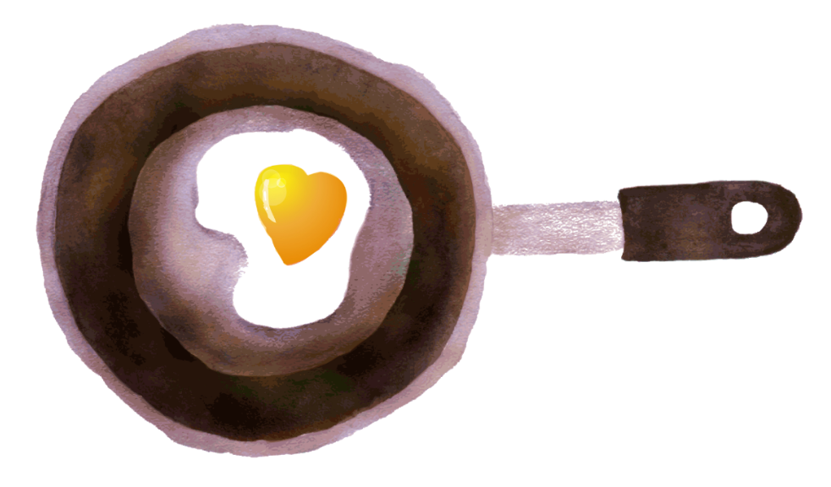
The Texas Panhandle

Slide 2
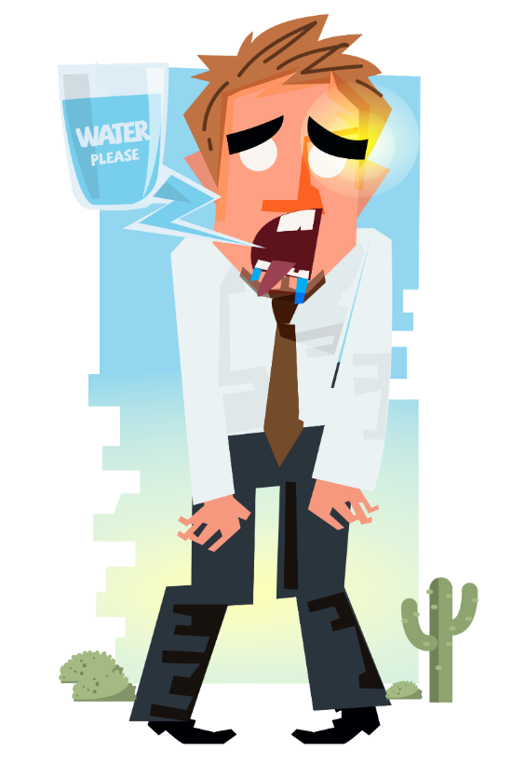
The Panhandle is parched, but there's no rain in sight to quench its thirst.

Slide 3
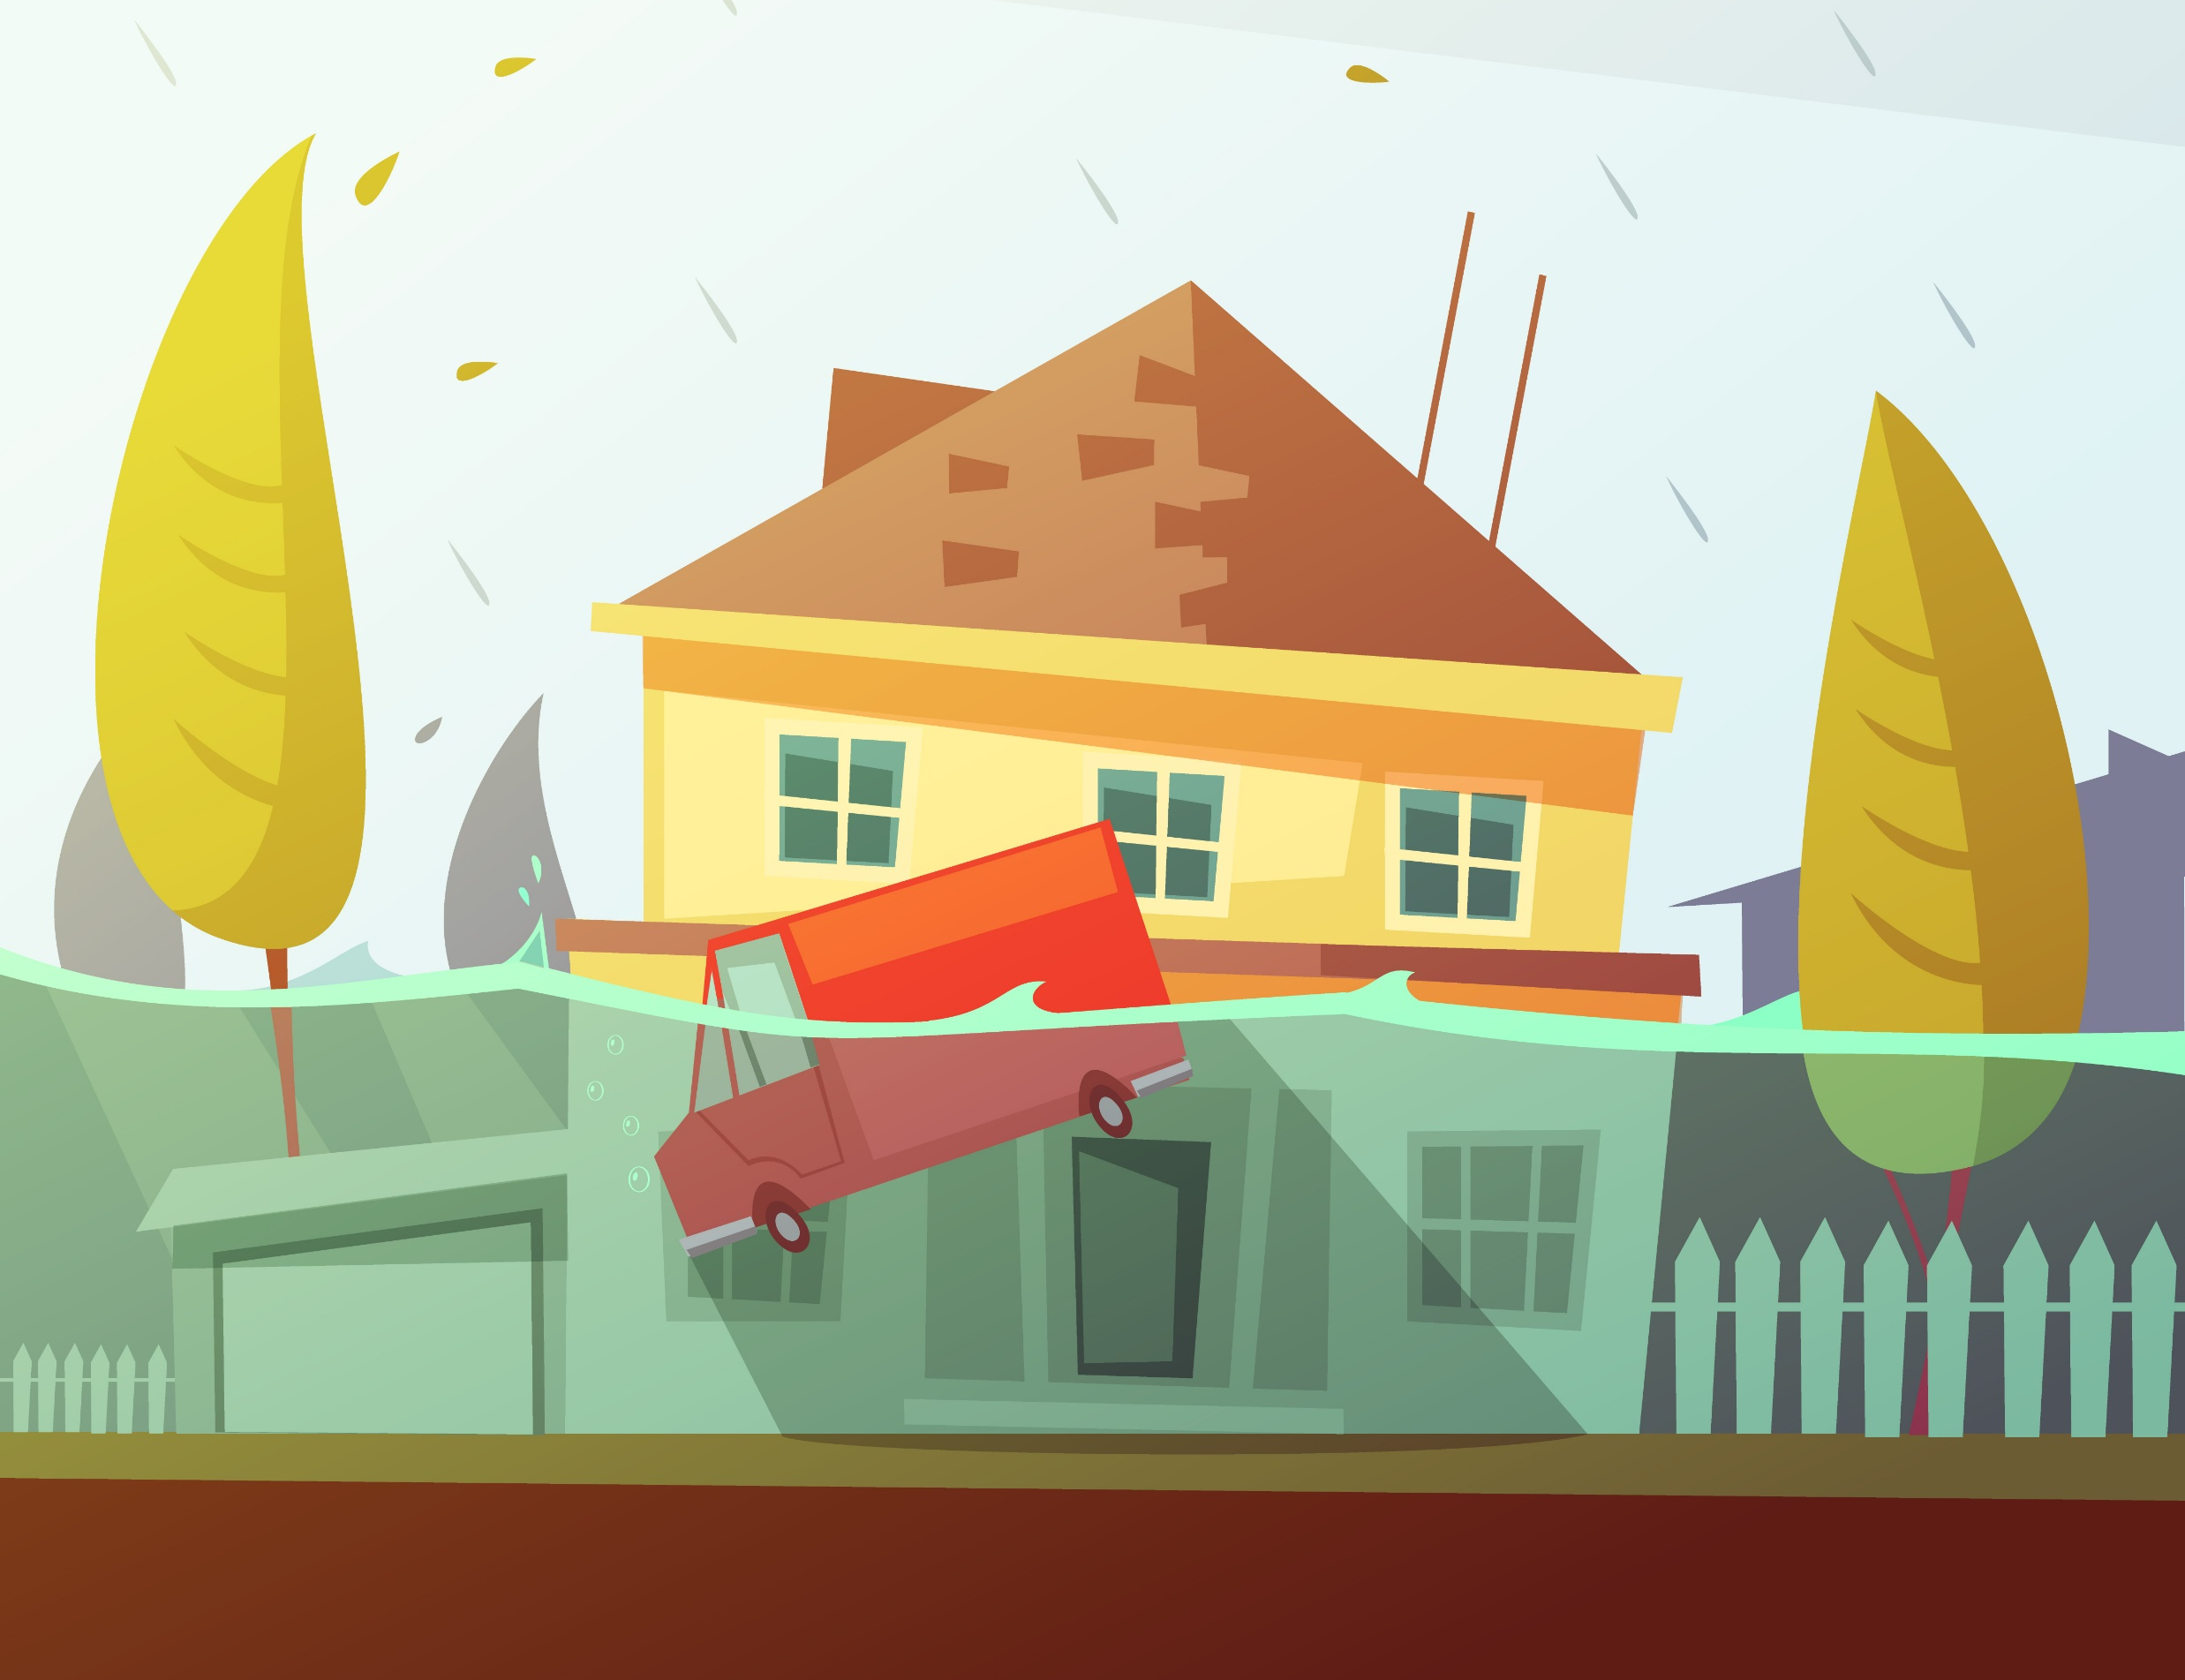
Water? Water? Anywhere?
The Texas Panhandle has become ground zero in a drought that has crept into much of the state just five months after Hurricane Harvey — including areas that suffered massive flooding during the storm.

Slide 4
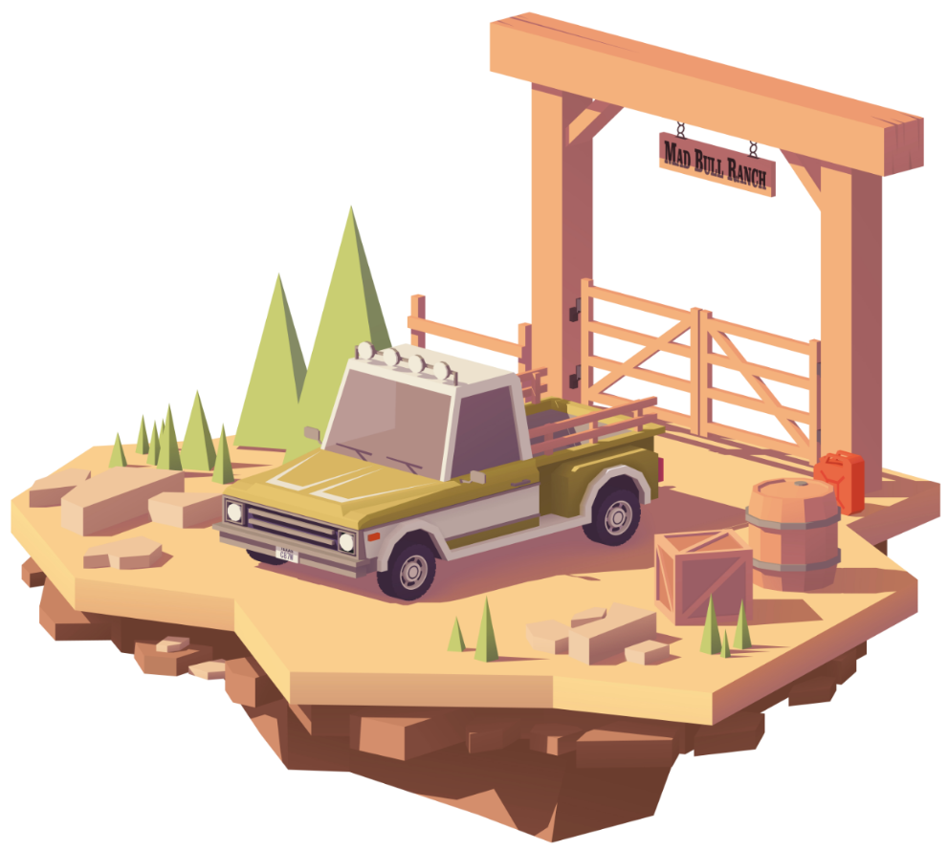
Having Flashbacks
Many farmers are having flashbacks to the drought of 2011 — the driest year in state history — and worrying that this one could rival it.

Slide 5
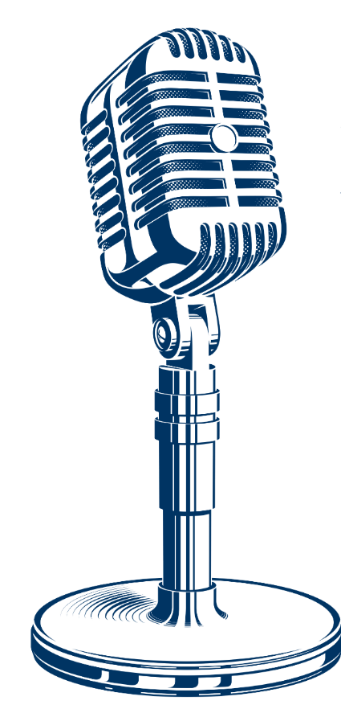
Breaking records!
On day No. 126, the streak finally ended. From October 13 to February 16, Amarillo didn’t see a single drop of measurable rainfall — a record rainless streak that plunged much of the Panhandle into a dangerous drought. The dry spell, which shattered the previous record of 75 consecutive days without precipitation, got the tiniest reprieve when 1/100 of an inch fell.
Some areas of the region went more than 130 days without any form of moisture this winter.

Slide 6
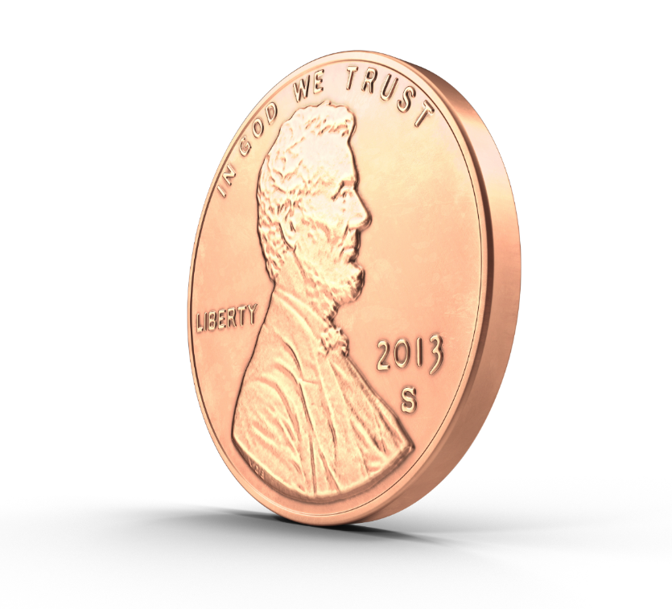
“I heard somebody say, ‘The rain was kind of like being broke yesterday and today you have a penny.’ The drought definitely still continues.”
-- Melissa Beat, a National Weather Service meteorologist in Amarillo.

Slide 7
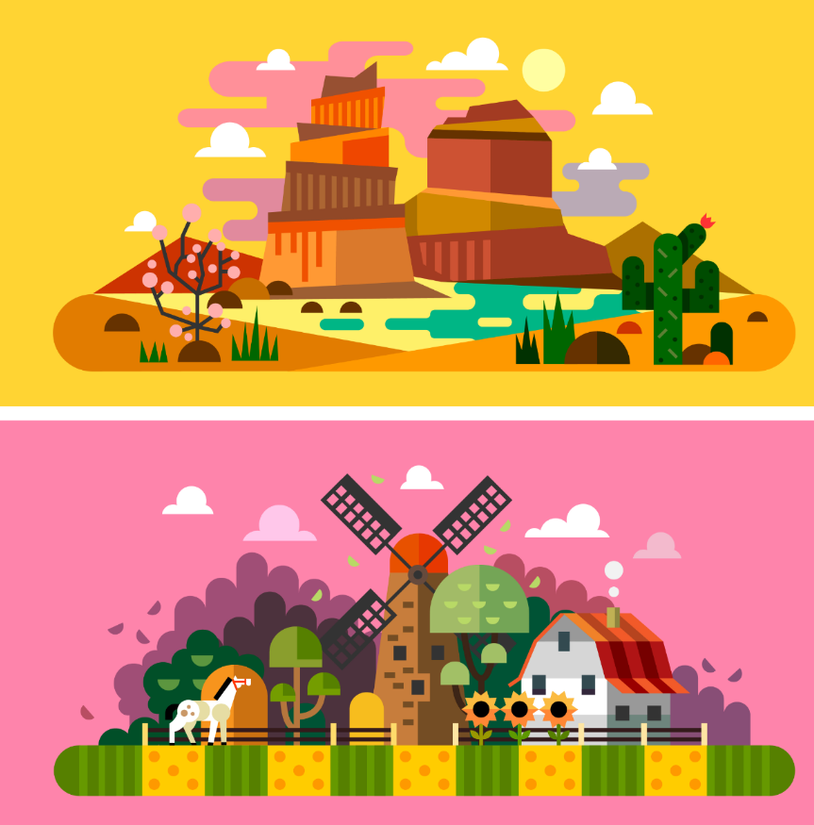
East vs West
It’s a tale of two halves in Texas, as farmers and ranchers in the western portion of the state are experiencing very different weather patterns than their eastern-based counterparts.

Slide 8
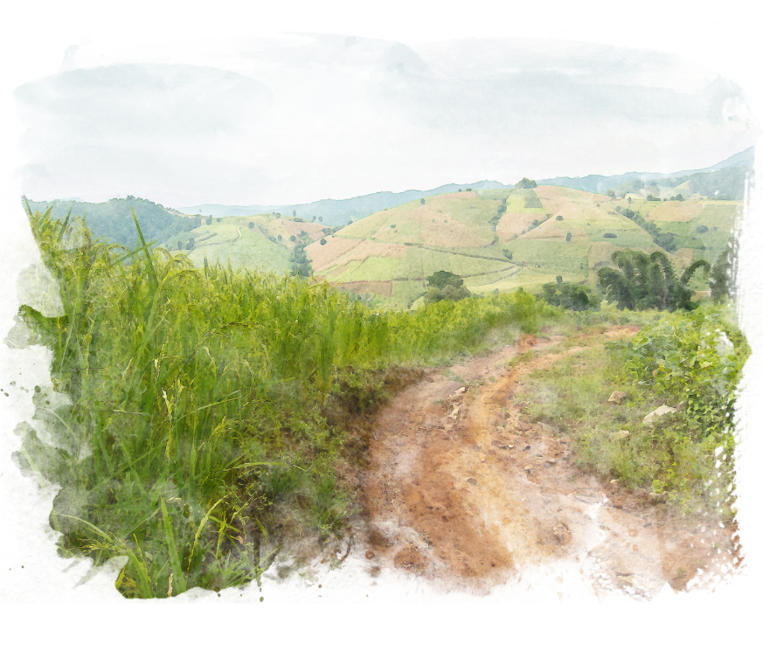
While rain has been scarce on the western end of the state, East and Southeast Texas have seen significant rainfall in the past few months and those regions are not experiencing any level of drought intensity thanks to recent precipitation.

Slide 9
Not your average weather
Much of the Western region has received less than half an inch of rain all year and the annual rainfall is supposed to be 18-25 inches per year. Ranchers in many areas face dire conditions as grazing lands dry up.

Slide 10
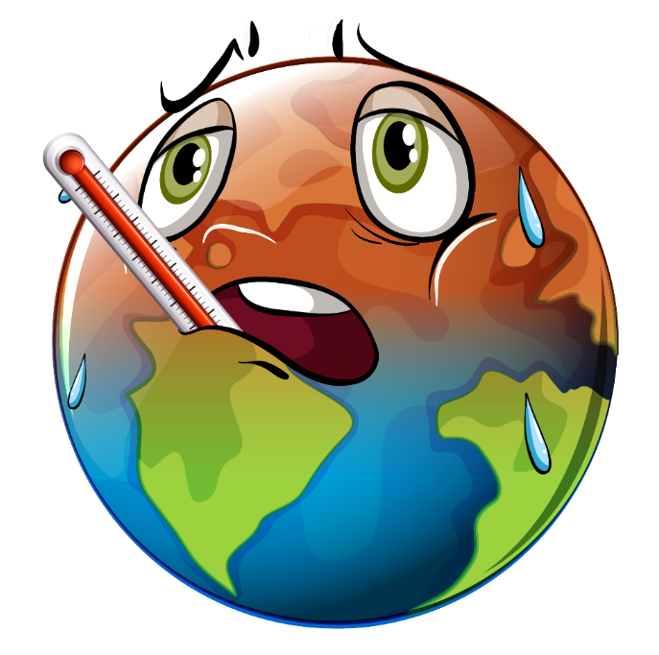
Does it feel warm to you?
The Panhandle is drying out in the face of a warming climate. In 2017, temperatures in Texas were “above average” or “much above average” throughout most of the state, and overall the state saw its second warmest year on record.

Slide 11
Is it really that dry?
If going months without rain or snow doesn't sound dry, consider that many locations in the southern High Plains have been drier since late-fall than Death Valley, California - 0.48 inches of precipitation from November through January - considered the hottest and driest location in the United States.

Slide 12
A Dry Outlook
According to the EPA, the number of 100-degree days per year is expected to quadruple in the Southern Plains by 2050, leading to “greater evaporation and surface water losses, more heat stress, and increased energy demand for cooling.” Parts of Texas and Oklahoma are “projected to experience longer periods without rainfall.”

Slide 13
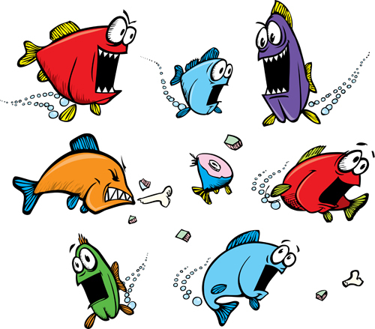
“Water is fundamental to all the interests, and, at times of scarcity, it can be a feeding frenzy, where all the interests are competing for a finite supply.”
--Luke Metzger, executive director of Environment Texas

Slide 14
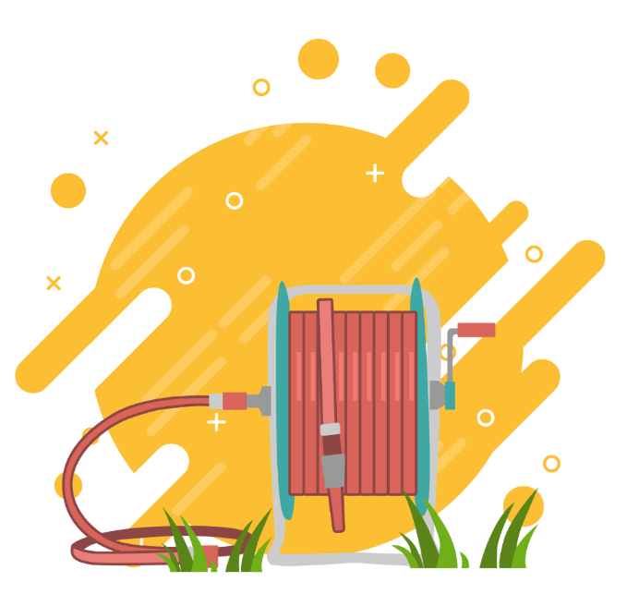
Where will they find water?
In lieu of rainfall, Panhandle farmers will have to pull more water from the Ogallala and Edwards-Trinity aquifers to keep crops and animals alive.
E.g., A single quarter-pound hamburger requires about 460 gallons of water to raise and process the beef.

Slide 15
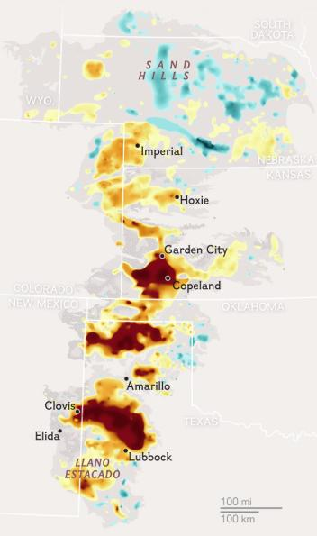
That doesn’t sound so bad, right?
The Ogallala, one of the world’s largest and most depleted aquifers serves as the main source of water for TX farmers and growers in seven other states. Cotton and sorghum growers and some producers have already started irrigating winter wheat as well.

Slide 16
What is the Ogallala?
The Ogallala is a giant underground sponge made of a jumble of gravel, silt, sand, and clay. All the water is contained in crevices of the sponge. If the topsoil were rolled up like a carpet, Wilson says, the sponge beneath would look like an empty egg carton, with peaks and valleys of varying depths.

Slide 17
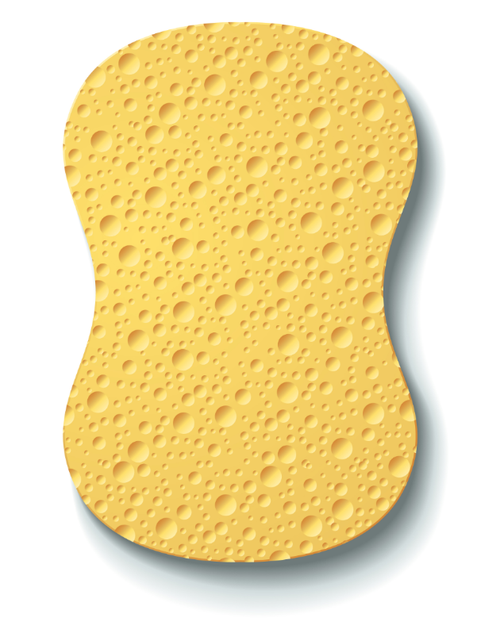
The sponge is drying out
The water beneath our feet has been accumulating in porous rock for about 15,000 years, before the end of the last ice age. For the past 60 years, the Ogallala has been pumped out faster than raindrops and snowmelt can seep back into the ground to replenish it, thanks largely to irrigation machinery.
The decline is steady now, dry years or wet. Transition to a new era of permanent depletion is under way.

Slide 18
Facing Hard Choices
“Farmers can reduce consumption of water to further extend the life of the aquifer. Or they can continue on a path toward an end that is already in sight.”

Slide 19
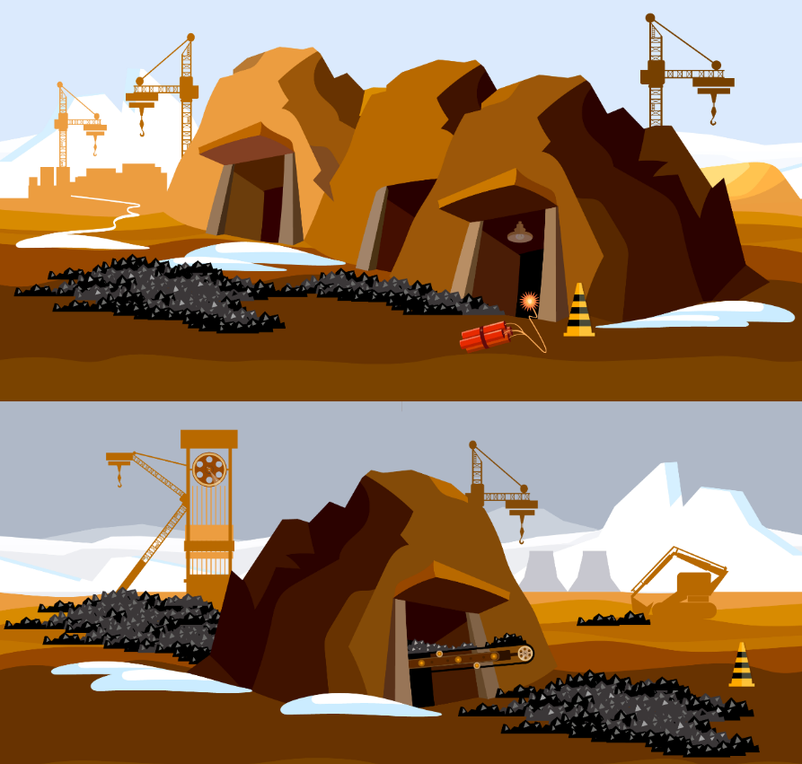
Who has the rights?
Water law in Texas is vastly different than other states. Groundwater is not publicly owned; Texans can pump as much as they can use from beneath their land.
Some farmers, “think it’s my water, and I ought to be able to mine it like coal until it’s gone.”

Slide 20
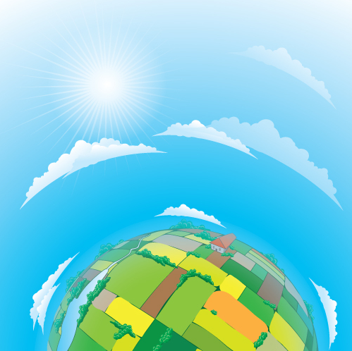
What will happen if we don’t slow down?
If we don’t reduce pumping and the aquifer is drained, food markets will be profoundly affected around the world. In the coming decades this slow-speed crisis will unfold just as the world needs to increase food production by 60%, according to the United Nations, to feed more than nine billion people by mid-century.

Slide 21
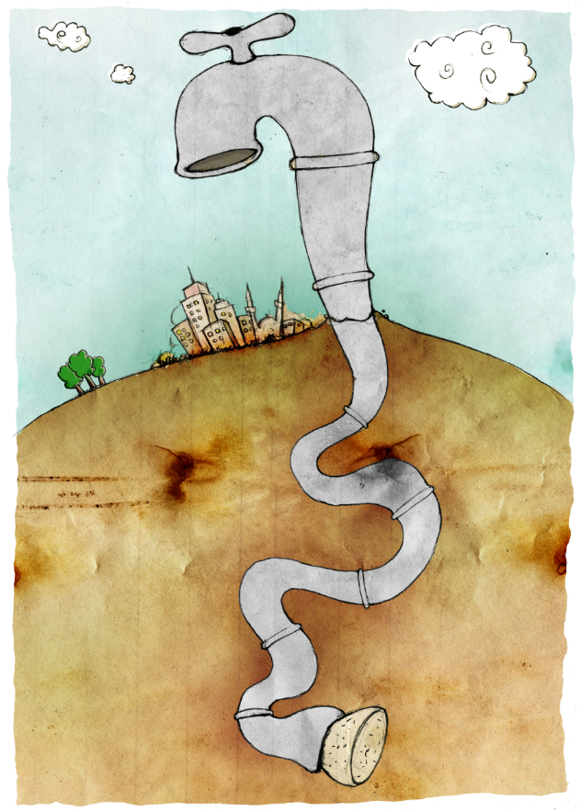
Won’t it fill back up?
The draining of North America’s largest aquifer is playing out in similar ways across the world, as large groundwater basins in Asia, Africa, and the Middle East decline rapidly. Many of these aquifers, including the southern Ogallala, have little ability to recharge. Once their water is gone, they could take thousands of years to refill.

Slide 22
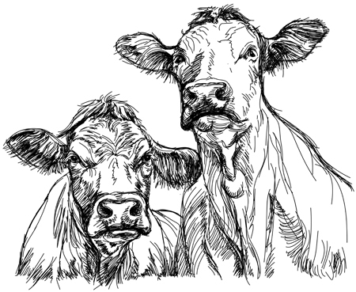
A balmy evening
The aquifer’s decline will be twinned with the increasing impacts of climate change, which will add more warm days and longer, more frequent droughts, scientists predict.
Already, warmer-than-average evening temperatures in feedlots mean that beef cattle drink more water than they did in cooler years.

Slide 23
“The consequences will be huge. We need to sustain groundwater to sustain food production, and we’re not doing it. Is draining the Ogallala the smartest thing for food production in the U.S. and globally? This is the question we need to answer.”
-- Jay Famiglietti, senior water scientist at NASA Jet Propulsion Laboratory and lead researcher on a study using satellites to record changes in the world’s 37 largest aquifers.

Slide 24
Farming without irrigation?
Irrigated land is worth more and earns more than dryland farming, and pressure is on to keep pumping—from seed salespeople, farm equipment dealers, bankers, insurers, and landlords.

Slide 25
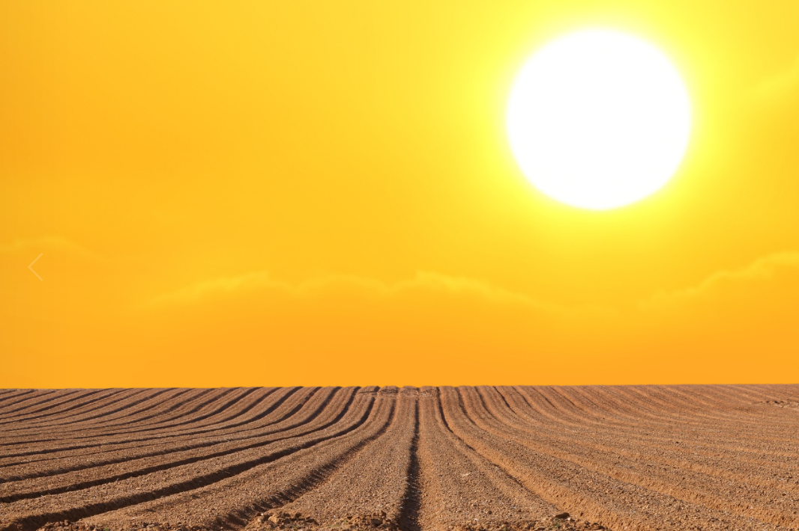
This is dry land, this is your land…
As more farmers return to dryland farming, large farms are likely to swallow smaller family farms, because dry farming, with lower yields, requires more land to be profitable. Irrigation will disappear from most places, so more small towns will fade away.

Slide 26
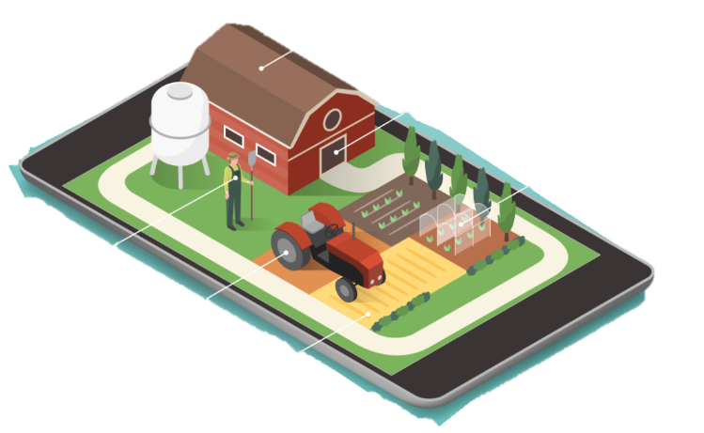
“Hope lies in technology”
There are apps that track water use so precisely that as little as a tenth of an inch can be applied to crops.

Slide 27
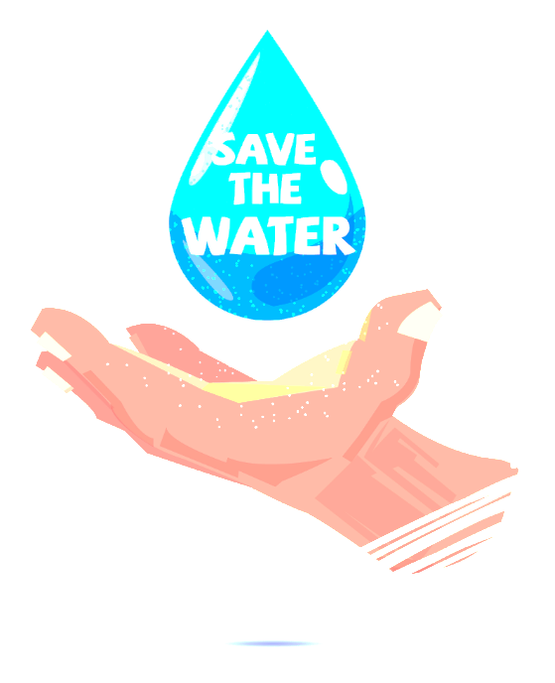
“A couple of generations from now, people are going to look back and say: What the hell were they thinking?”
-- Burke Griggs, water law expert, Washburn University, Topeka

Slide 28
Feeling the Burn
The cycle of extreme drought and extreme rainfall is also exacerbating wildfires in the Panhandle. As the drought persists, fire dangers increase across the region.

Slide 29
Catching the Pan on Fire
Parts of the Texas Panhandle have been devastated by wildfires. The Texas A&M Forest Service estimates 34 fires have burned 90,208 acres across Texas.

Slide 30
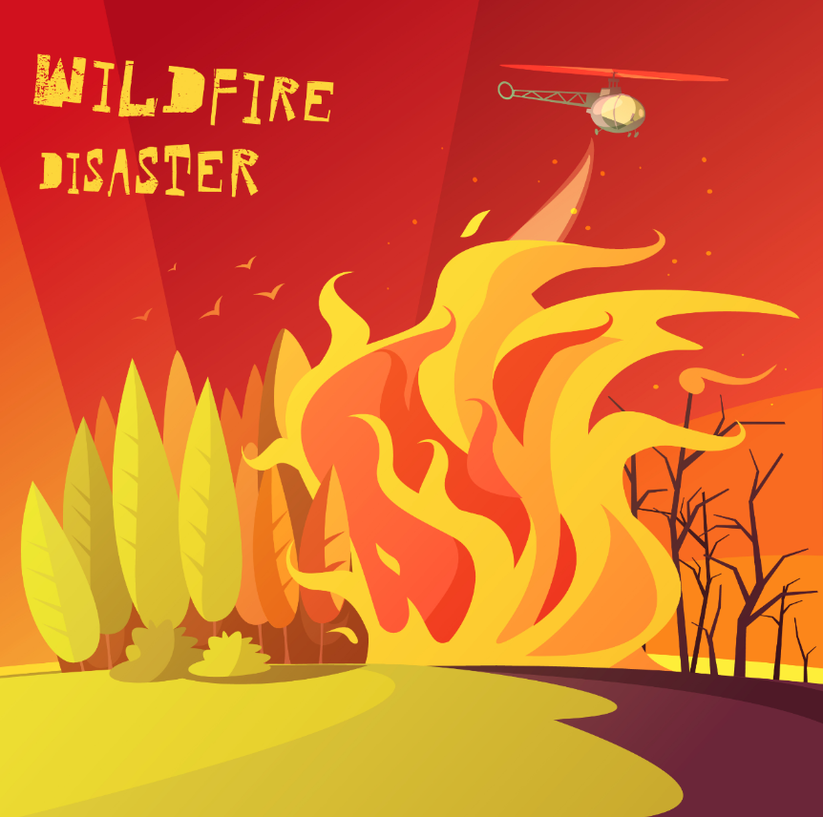
The Texas Panhandle continues to work to recover from the blaze that killed ranchers, cattle and horses, and destroyed grasslands and property across a half-million acres in 2017.

Slide 31
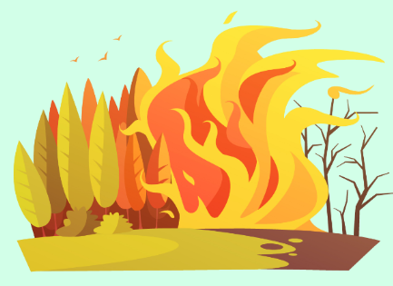
A deadly combination
Texas wildfire potential is due to “a combination of higher winds and very low humidity levels combined with dry fuels.”
Those fuels are a result of plant growth (grasses and woody plants) spurred by unusually heavy rains from the spring and summer of 2017 that are now parched from a severely dry winter in the Texas Panhandle.

Slide 32
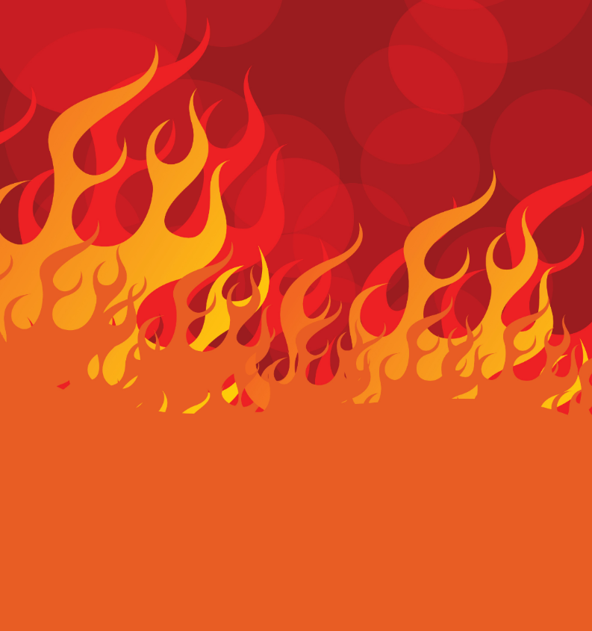
Wildfires, a perennial threat in this part of Texas, use the dry, crispy material to grow to monstrous proportions. Fuel loads are exacerbated by a USDA conservation program that pays farmers to grow grass but does little to enforce rules requiring management of the resultant brush.

Slide 33
Lessons Learned
Thousands of miles of fencing were lost in the blazes, leading many farmers and ranchers to favor the installation of steel corner posts.
In addition, some ranchers are considering the merits of creating their own firefighting apparatus to compensate for when volunteer departments are overwhelmed and taking increased responsibility to protect and defend their property.

Slide 34
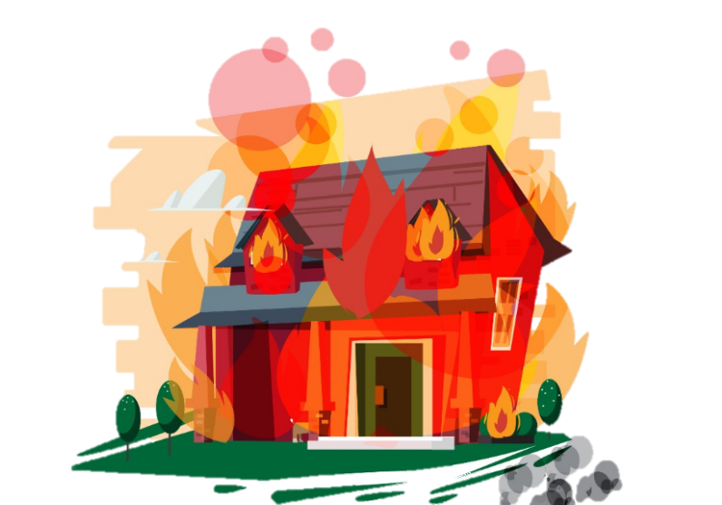
Knowing when to quit
“…take care of your cattle and your country but then also be willing and able to say 'I've done all I can do, I'm going to get out while I can.’”
--Shamrock, Texas rancher Trent Cadra

Slide 35
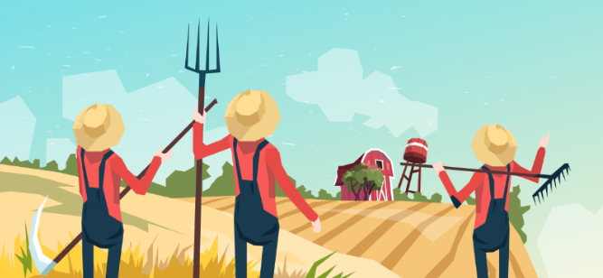
Panhandle cattle producers rely heavily on both native range and winter wheat for winter and spring forage. Without adequate winter precipitation, the wheat pasture has started to really decline.
As a result, many ranchers are having to pull cattle off pastures earlier than intended.

Slide 36
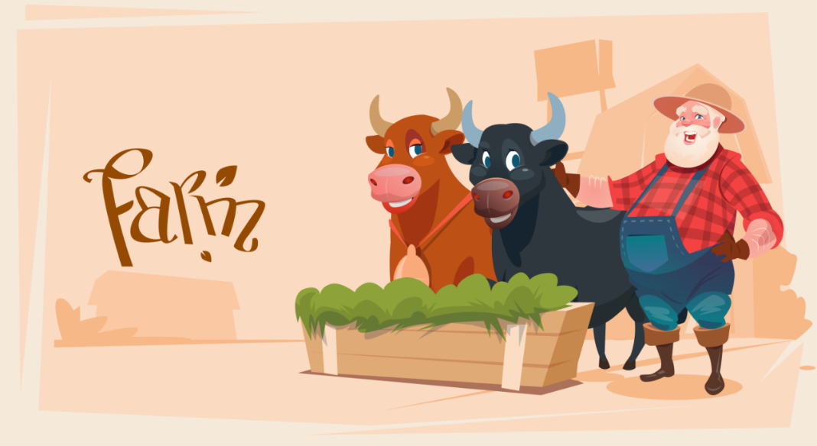
The lack of significant rainfall in the area has forced many to extend supplemental feeding—a chore they may have to continue if precipitation levels remain low.

Slide 37
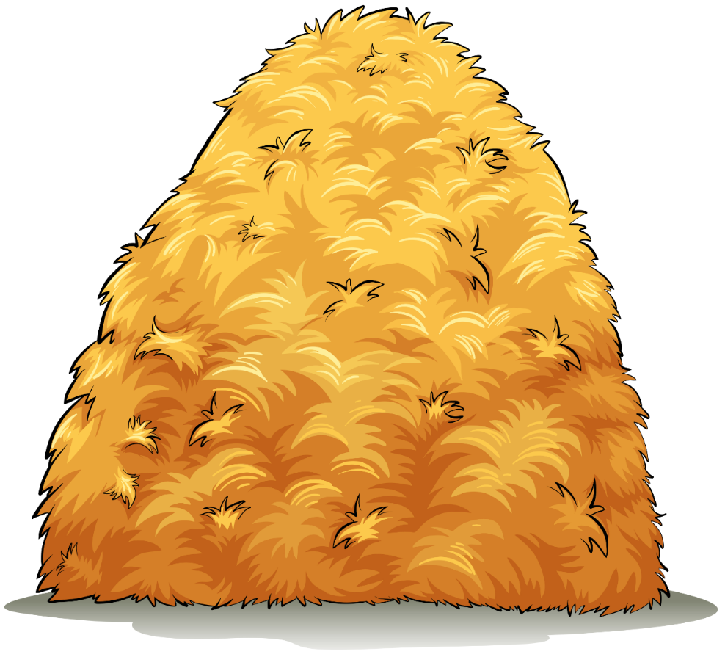
In addition, silage production is very important to the region’s feedlots and dairies.

Slide 38
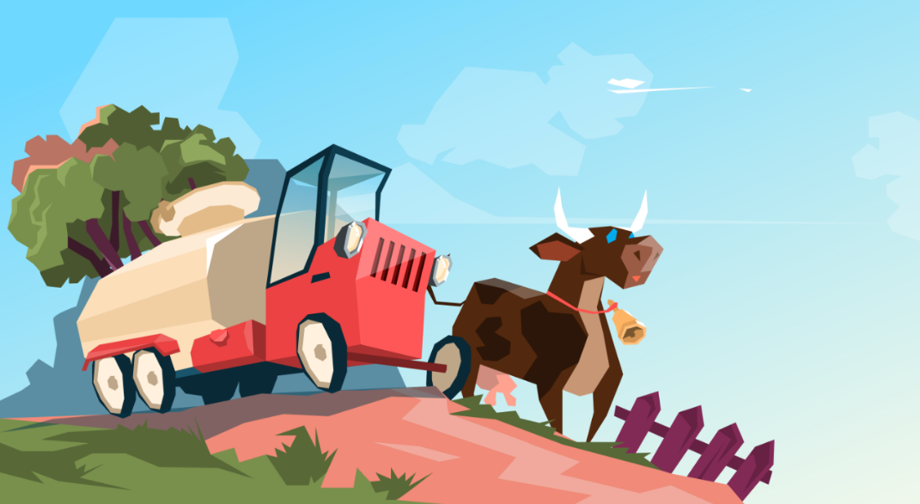
Silage is a crucial component for dairy and feedlot rations. Silage, unlike grains, must be produced locally. It is difficult for a dairy producer to have enough land, not only for his dairy operation, but to grow feed for an entire herd. Many dairies rely on neighboring farms for silage to meet feed requirements for their herds.

Slide 39
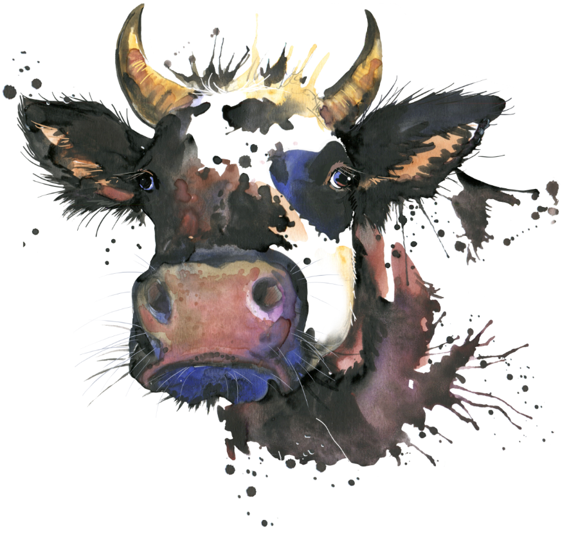
Hungry!
The average lactating dairy cow needs approximately 90 pounds of feed per day. This feed must possess adequate protein and be easy for cattle to digest, relatively inexpensive and readily available.

Slide 40
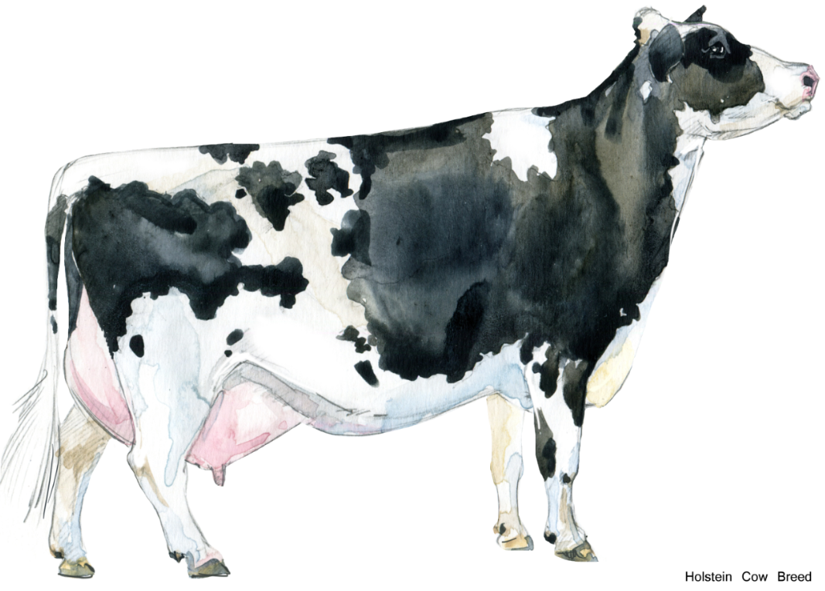
Order up! More mouths to feed!
With the rapid increase in the number of dairy cows in West Texas, it is expected corn silage would keep pace. However, the two aren’t even close.

Slide 41
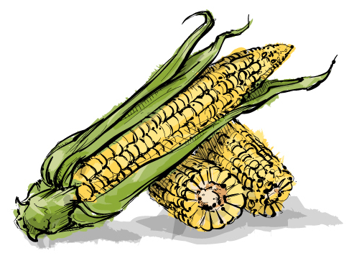
Are they really related?
A possible misconception is that corn silage and dairies are not strongly related, when in reality there should be a strong, positive correlation between the two.

Slide 42
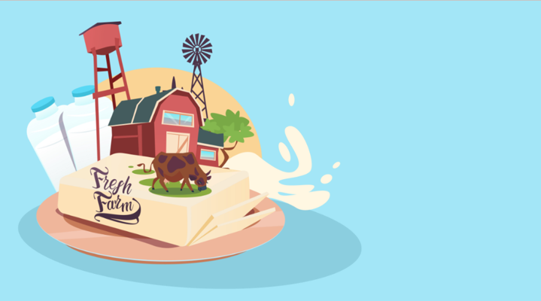
Not keeping up
Corn silage production has increased by 1.7-fold in the northern High Plains and the southern High Plains from 2000 to 2008. While the number of dairy cows has increased 30-fold in the past 10 years in the northern High Plains and four-fold in the southern High Plains.

Slide 43
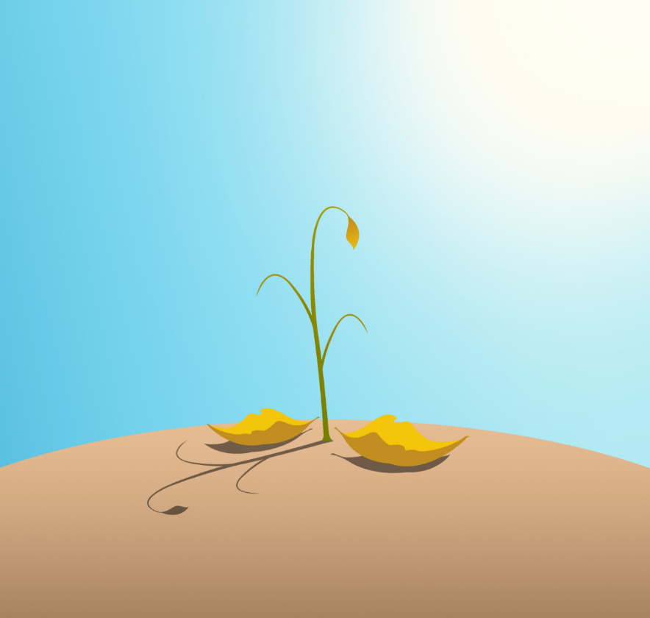
Some farmers are considering different types of seed—those that are more drought resistant—due to the drier conditions.

Slide 44
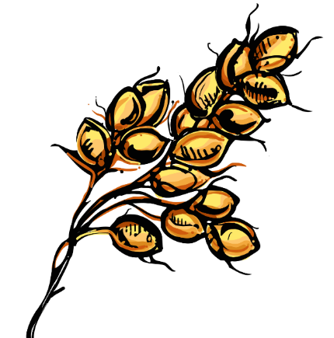
Sorghum saves the day?
Research shows switching from irrigated corn silage to irrigated sorghum silage has the potential to save water and production cost.
It’s estimated that switching 30,000 acres from irrigated corn silage, irrigated grain sorghum, and dryland grain sorghum to irrigated sorghum silage would result in economic benefit amounting to $4.904 million. There is potential to save 116,373 ac-ft. of water.

Slide 45
A hope and a plane?
Several drought-stricken counties near Abilene may soon see cloud-seeding planes in the sky. Those on the ground hope they are followed by thunderclouds and rain.

Slide 46
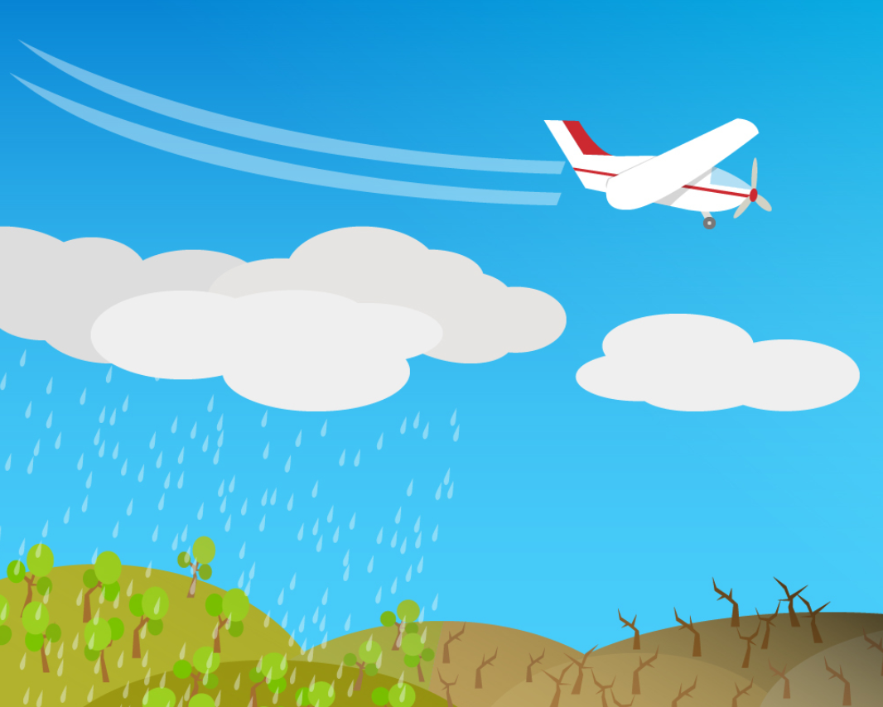
The technology works by using two different chemical agents to encourage larger water droplets to form around ice crystals deep inside clouds, then migrate to warmer parts of the cloud where it will fall as precipitation.

Slide 47
Not sure it works, but have to try
“We went four years here in Nolan County on 30 inches of rain total, and our annual rainfall for this area is supposed to be 25 inches a year. So, we thought that we had to do something to at least try to help the situation.”
--Dale Adams, manager of Wes-Tex Groundwater Conservation District

Slide 48
To cull, or not to cull?
Available forage on rangeland and pastures west of the Pecos River is becoming scarce.
“Wheat hasn’t had the moisture to get the growth producers need for normal stocking rates. They’re having to rethink their plan. Some producers are culling. Those who aren’t probably need to be looking at their pastures and deciding when and what cattle to cull or whether they might be able to make the next rain.”
--Dr. Bruce Carpenter, livestock specialist for Texas A&M AgriLife Extension Service

Slide 49
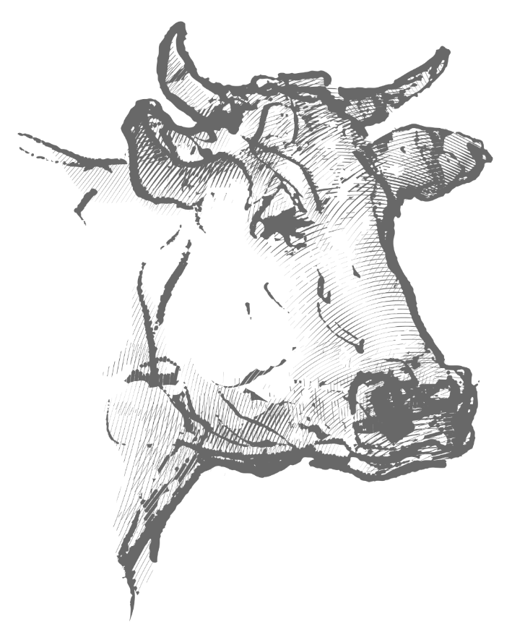
No food on the range
Many ranchers have had no choice but to send their animals to yards where they’re fattened up for market with grains. That speeds up the growing process and means the animals will go to market earlier than usual.
Some analysts also cite cheaper feed in Corn Belt states’ lots, which lowers input costs for feedlots, as another factor.

Slide 50
Feeding a lot sooner
Ranchers sent nearly 1% more cattle to U.S. feedlots in December than the same time a year earlier, topping analysts’ predictions. And more heifers are entering feedyards, suggesting that the rate of herd expansion is slowing.

Slide 51
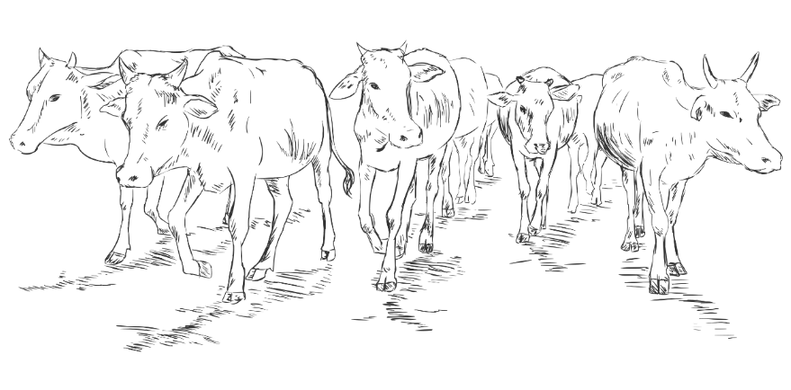
1% might not sound like much, but…
Amid the dryness, farmers placed 1.82 million cattle in feedlots in February, up 7.3% from the prior year, according to a USDA report released March 23. Placements in previous months were also higher, including a notable 14% jump in November.

Slide 52
What does it mean?
"The big placement figure tells you that we're going to have big numbers of cattle coming at us for the foreseeable future."
-- U.S. Commodities President, Don Roose

Slide 53
Won’t a glut drive down prices?
Retail-beef prices tend to lag behind the futures market. In the second quarter, cattle prices will probably be about 20% lower than last year, while retail beef will be down about 9 %.

Slide 54
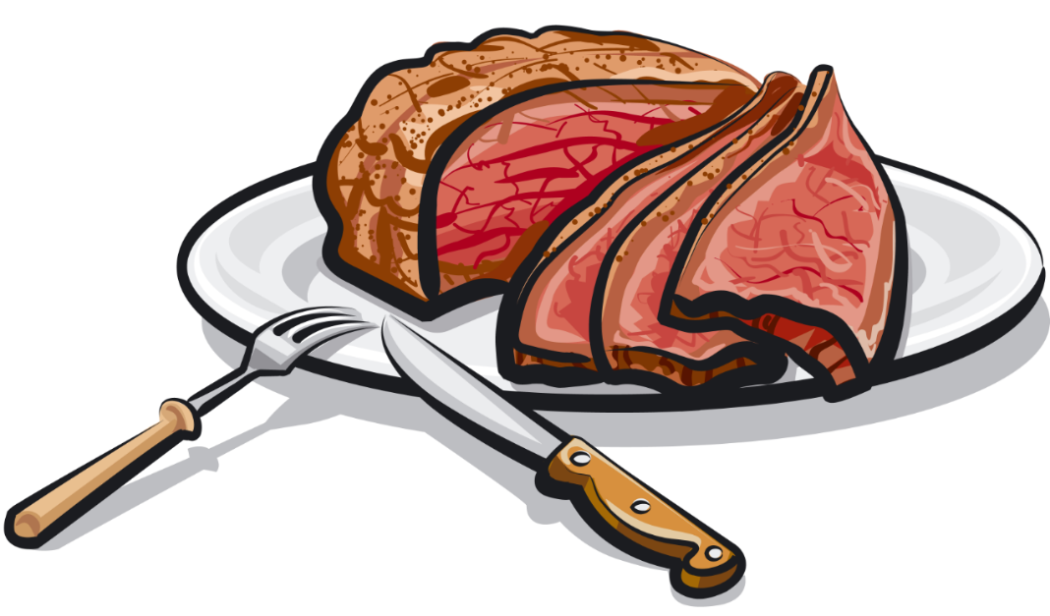
“Still, lower prices may not last long if they entice more buying. Global demand for beef is still strong, the U.S. economy is humming along, and consumer satisfaction is high. All that points to how confident the consumer feels and how willing people are to part with their dollars and spend money on a premium protein, like beef.”
--Altin Kalo, an analyst at Steiner Consulting

Slide 55
More than just beef
It’s likely Texas will become a Top 5 milk producing state in the nation this year, passing Pennsylvania, but where that milk is produced has shifted dramatically over the past four decades.

Slide 56
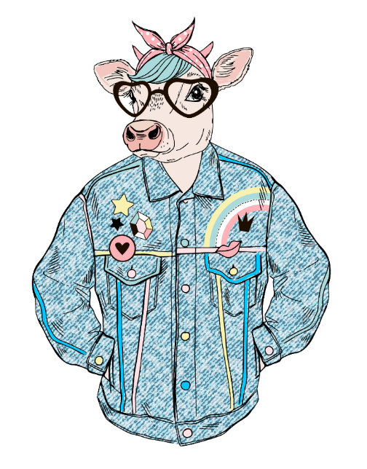
The 80s. Big Hair. Big Dairy.
In 1980, almost 25 percent of TX milk was produced in Northeast Texas. Hopkins County was the dairy capital of the state and produced 16 percent of the state’s 3.5 billion pounds of milk that year. By 1990 Central and Northeast TX produced 57% of the state’s milk.

Slide 57
Dairy production in Northeast Texas rapidly declined over the next two decades as milk production moved west to a region that accounted for less than 1% of production in 1980 – the Panhandle.

Slide 58
Dairy on the moove
Heavy rainfall, animal welfare, quality of life for producers, the economics of production and other factors all contributed to the move from East Texas.

Slide 59
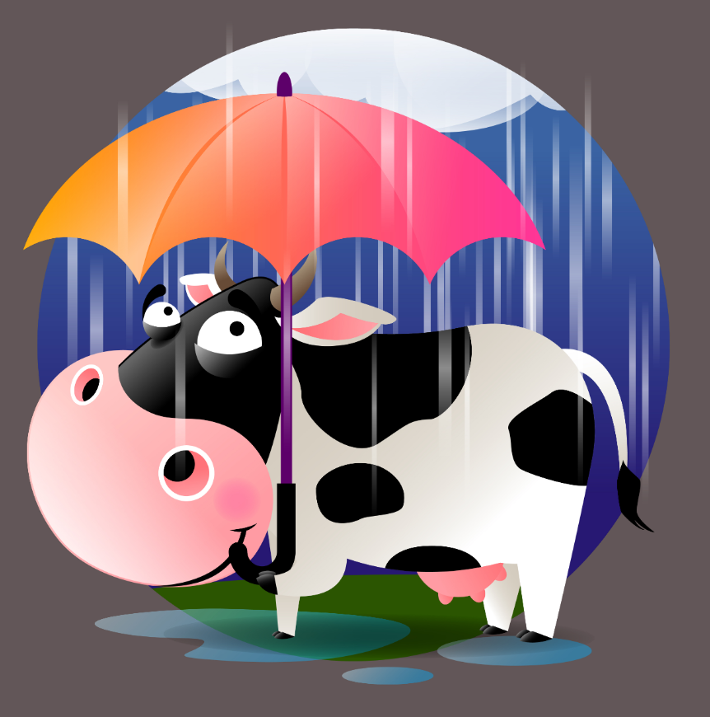
Too wet for dairy?
East Texas weather, including up to 50 inches of annual rainfall, heat and humidity, affects cows and can reduce herd production significantly, including milk pounds and fertility rates.

Slide 60
It’s easier to cool cows in the summer and warm them in the winter in areas where humidity levels are low.

Slide 61
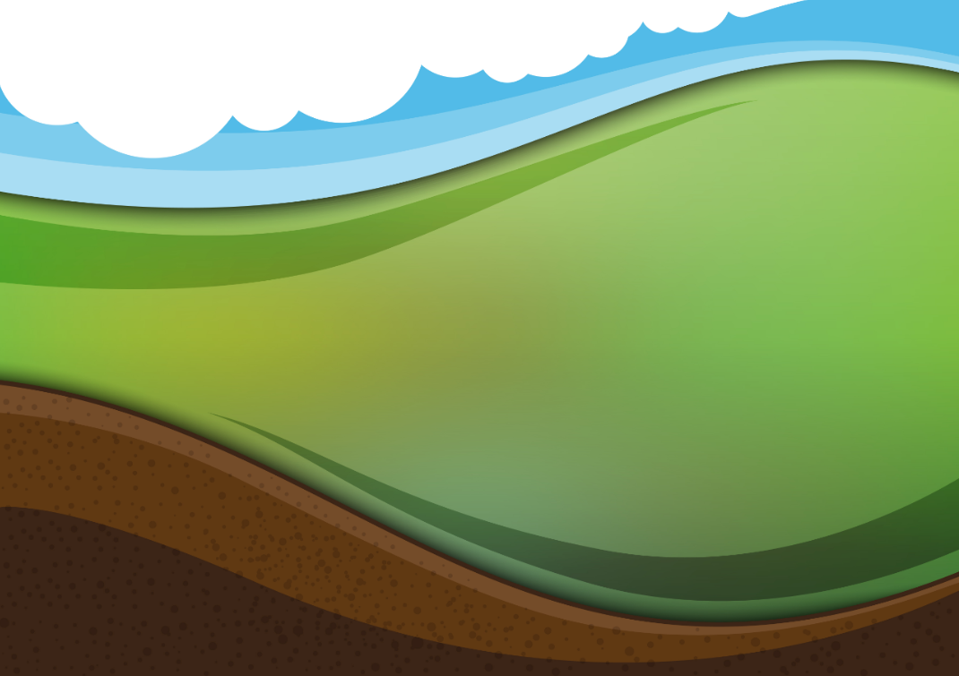
The Perfect Spot!
The Panhandle was a good option because of rainfall amounts and land availability. It also provided a steady supply of high quality feed because of the well-established feedlot industry in the region and the abundance of cottonseed, which dairy cows like.

Slide 62
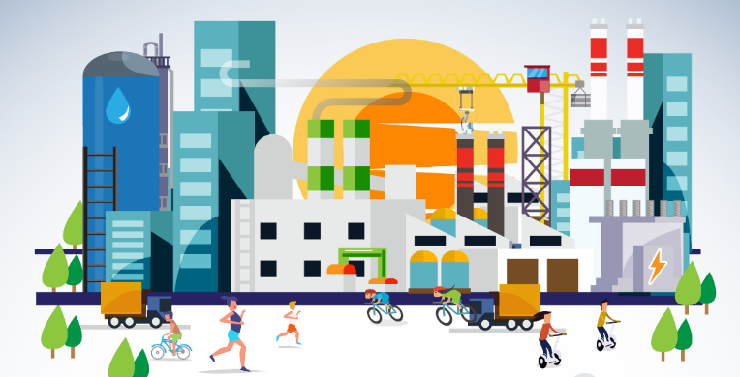
Landowners also faced the increased demand to sell as encroaching development and suburban sprawl placed a premium price on their land holdings.

Slide 63
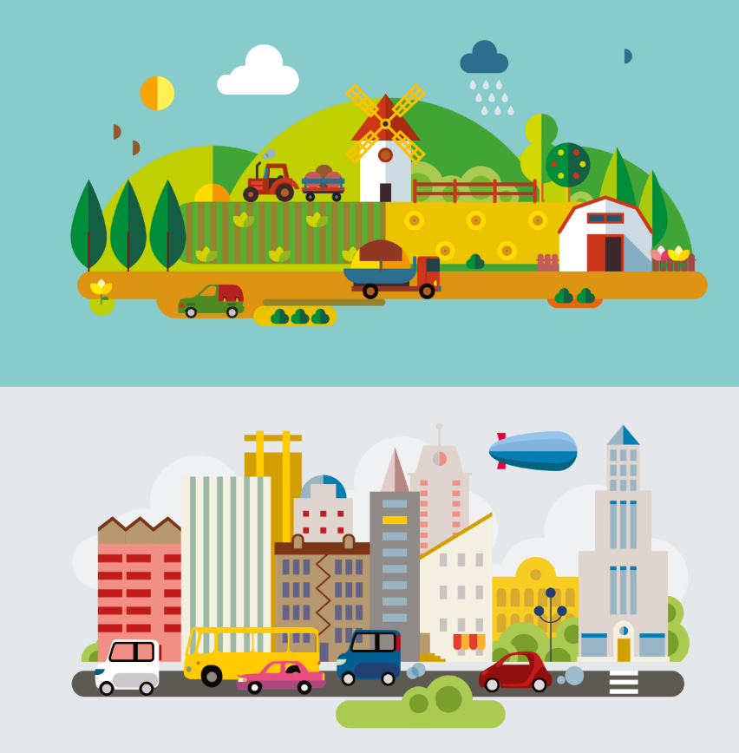
Dairy operations that hoped to expand needed additional space and finding contiguous parcels meant paying premium prices for land if they stayed where they were.

Slide 64
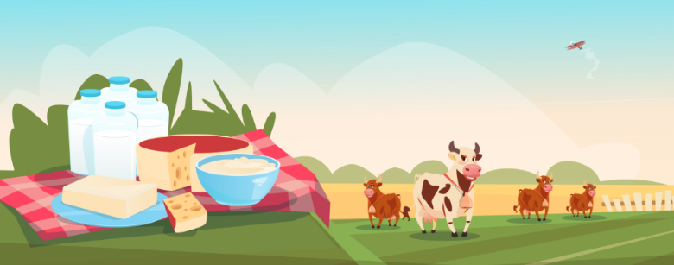
A combination of economic, logistical and environmental factors helped the Panhandle emerge as an ideal location for dairy producers. Since the 1980s, milk production in the region boomed from less than 1% to more than 68% in 2017.

Slide 65
What about now?
Some dairy farms are closing and others are struggling to stay open. Tough conditions are causing many farmers to sell off a big percentage of their cattle.

Slide 66
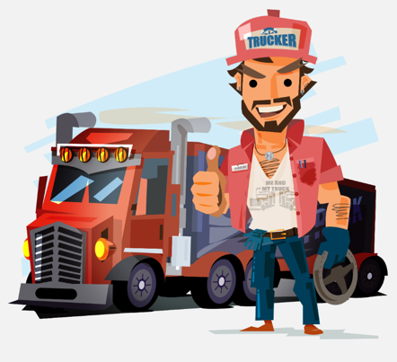
"When you can't produce crops, you have to haul in the feed so we're hauling feed as far out as Canada and the trucking with the fuel prices, you know we just can't afford those.”
--Art Schapp, Owner, Highland Dairy

Slide 67
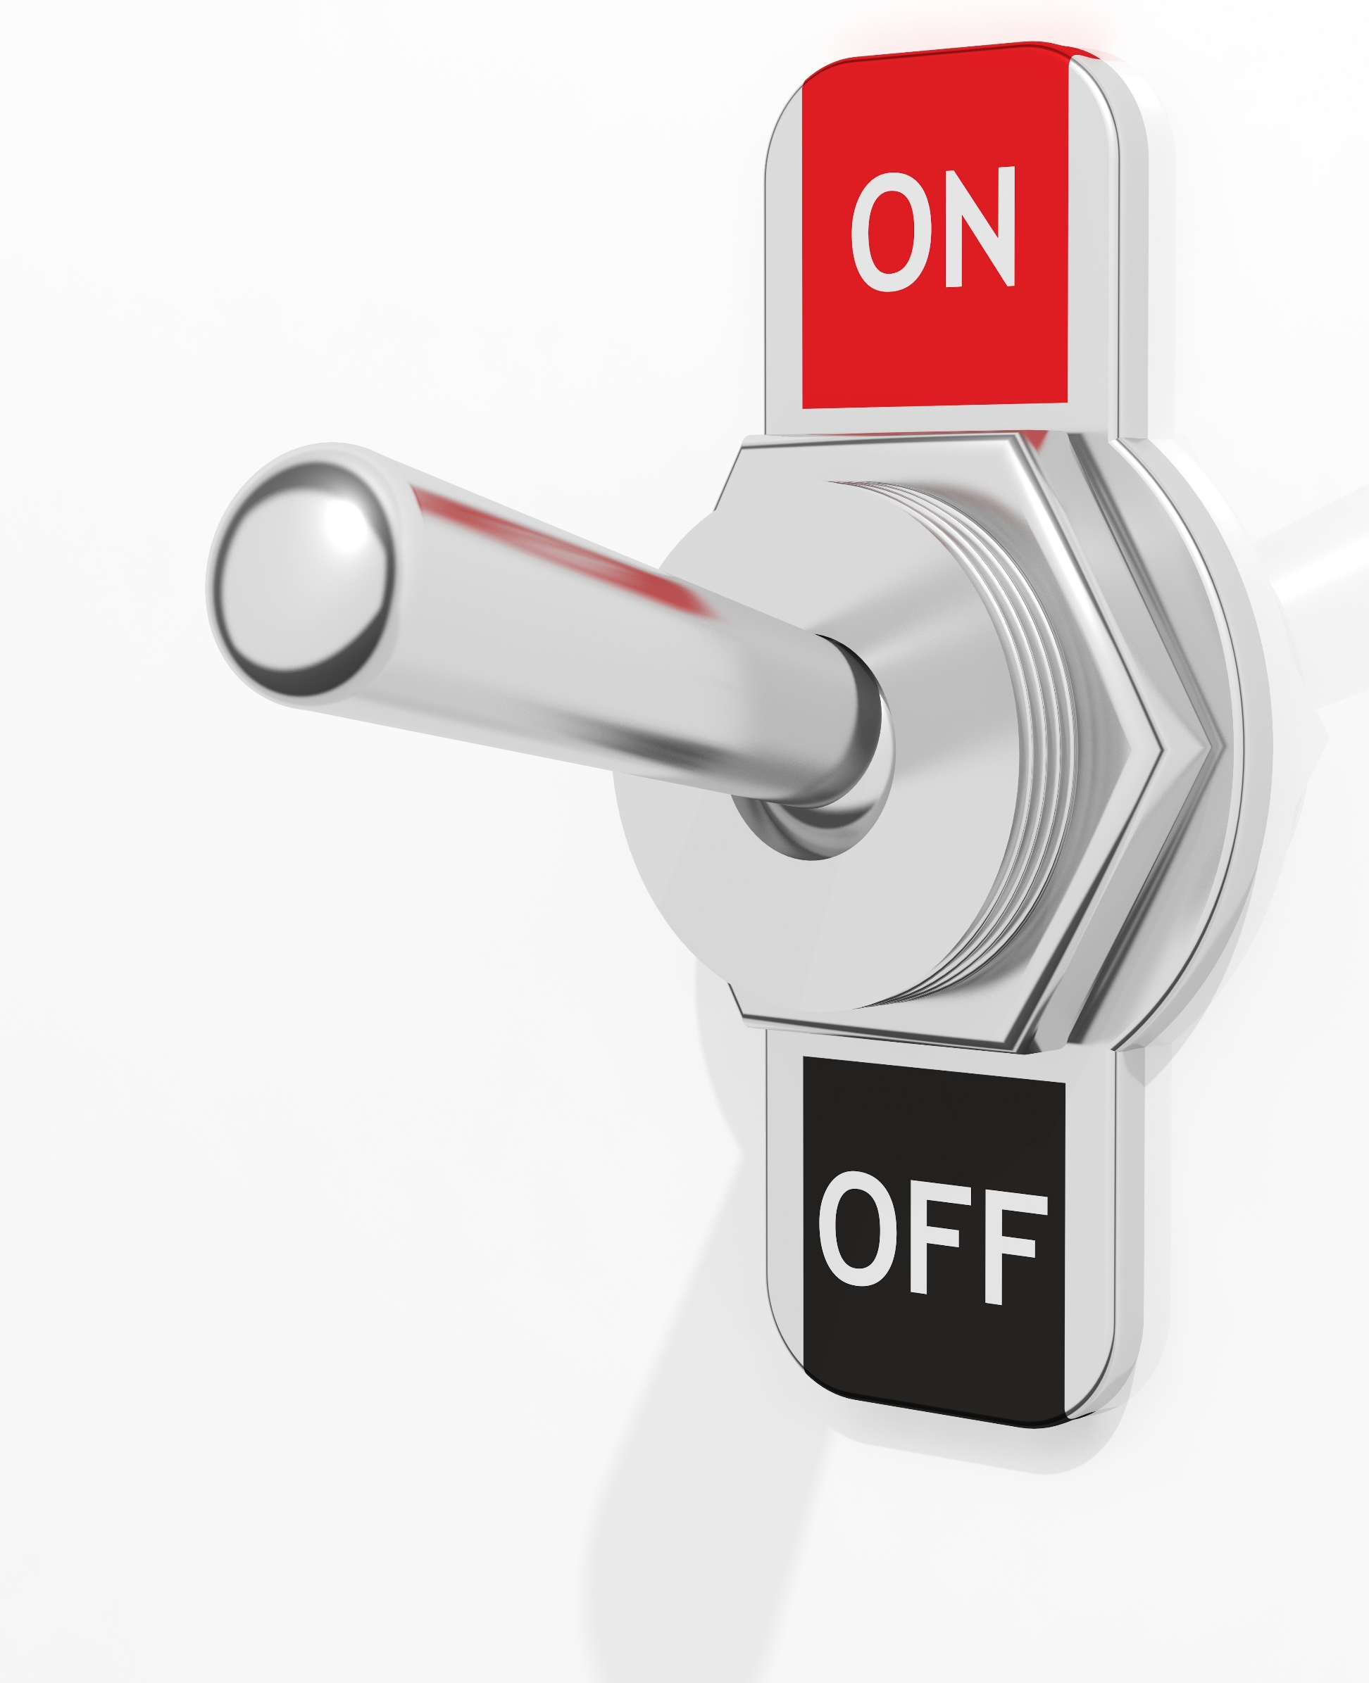
You can’t turn a dairy cow off and on
Cows have to be milked every day. Plus the drought and the ethanol subsidy on corn has caused additional challenges.
Farmers have moved their cattle to other states to feed them; Colorado, Nebraska and into Missouri where they can graze. Many are also selling cattle trying to reduce debts.

Slide 68
Milk production taking a hard hit
Farmers expect a milk shortage as early as the fall and prices are anticipated to go up for consumers.

Slide 69
"There are 40 less semi-loads of milk going to the market right now compared to last year. [Which is nearly two million pounds less a day.]"
--Art Schapp, Owner, Highland Dairy.

Slide 70
Farmers are hoping the new farm bill in Congress will help control the supply of milk so dairies don't overproduce, among other things.

Slide 71
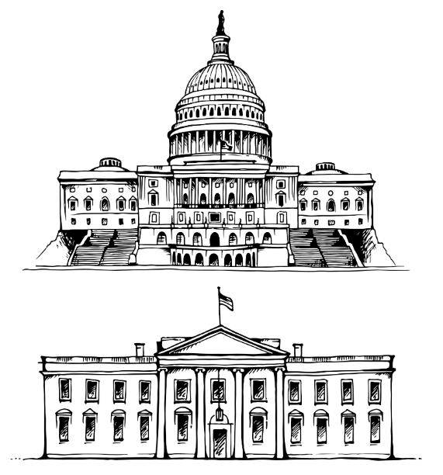
Congress getting their Act together on Ag
Texas Farm Bureau and 48 other agricultural groups in the Lone Star State are calling on Congress to support House Judiciary Committee Chairman Bob Goodlatte’s Agricultural Guestworker Act, also known as the AG Act.

Slide 72
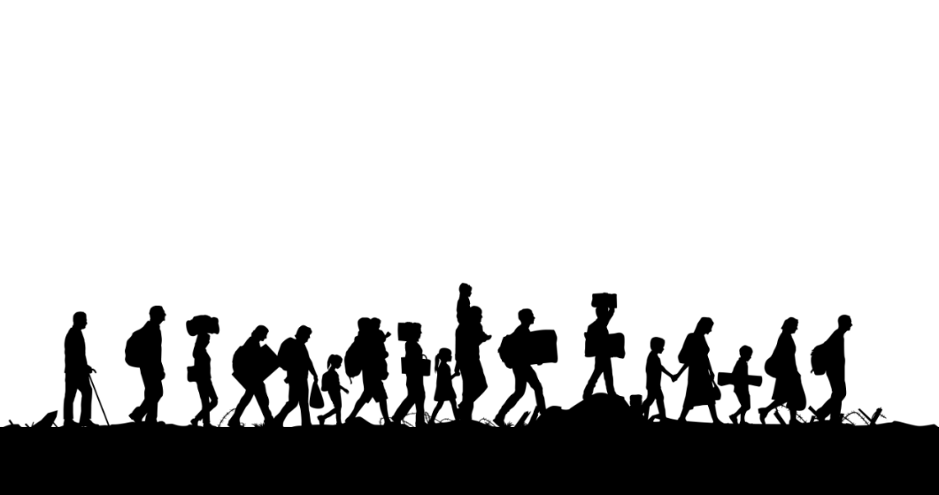
Texas is one of the largest in population growth and ranks near the top in domestic and international migration.

Slide 73
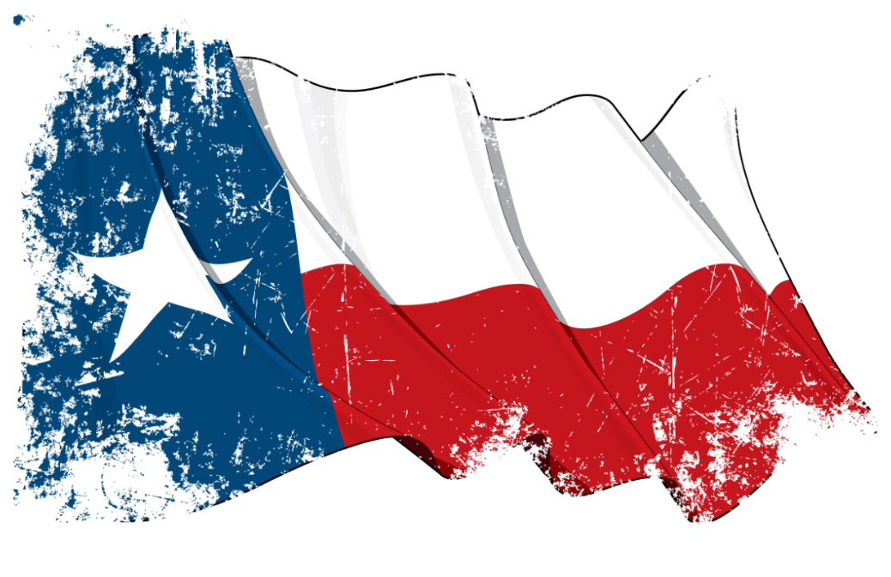
For many, many years, Texas has been known as a Mecca of the nation's overall agricultural production. It comes as no surprise Texas produces the most beef cattle. It's also the largest producer of cotton fiber and cotton seed, and the largest producer of wool and mohair. It doesn't end there. The Lone Star State leads the nation in horses, hay, sheep and goats, and is second in grain sorghum.

Slide 74
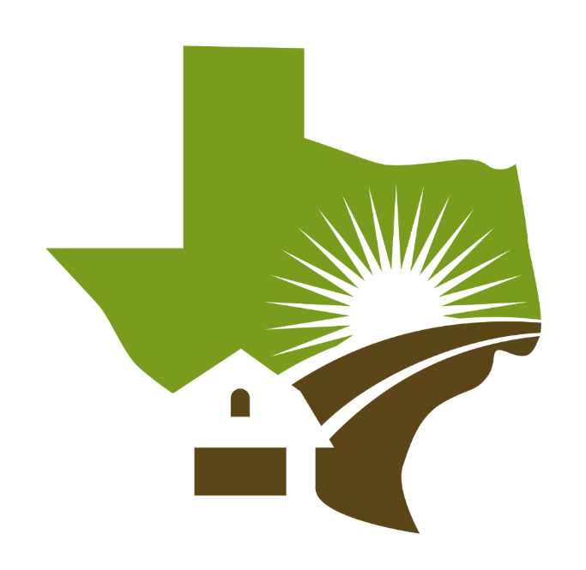
From food safety to the economy, agriculture is an important part of Texas, and by the ongoing growth of the industry in the state, it seems that it will continue to play a major role for years if not generations to come.

Slide 75
Hoping for H-2C
TX Ag organizations state that lack of a stable workforce for agriculture places domestic food production at risk.
“Increasing immigration enforcement without also reforming our worker visa program could cost America $60 billion in agricultural production. This situation makes U.S. agriculture less competitive with foreign farmers and less reliable for the American consumer. Securing a reliable and competent workforce is essential to agriculture, the economy and our national food security.”

Slide 76
What’s different from H-2A & H-2B?
The new program, called H-2C, would fall under the USDA instead of the Department of Labor, which is who currently administers the H-2A program.
It would be available to season and year-round agricultural employers like dairies, raw food processors, timber, aquaculture, and others.

Slide 77
Watering by WiFi?
Farmers and ranchers rely on data to grow more food, fuel and fiber than ever before while lessening their environmental impact.

Slide 78
“Today’s farmers and ranchers are using precision agricultural techniques to make decisions that impact the amount of fertilizer they need to purchase and apply to the field, the amount of water needed to sustain the crop and the amount and type of herbicides or pesticides they may need to apply.”
--Zippy Duvall, American Farm Bureau Federation (AFBF) President

Slide 79
Making the connection
The Senate Commerce Committee today approved S. 2343, the Precision Agriculture Connectivity Act of 2018, which would create a task force to focus on the connectivity and technology needs of modern farmers who are too often without broadband in the fields and on the ranches where they work.
FCC data shows that 39% of rural Americans lack access to minimum broadband speed service (25 Mbps/3 Mbps), compared to only 4% of urban Americans, there is no information about connectivity on cropland and rangeland.

Slide 80
Cost Sharing on Cotton
The USDA’s Farm Service Agency (FSA) is administering a program where cotton farmers will receive a cost share payment based on their 2016 cotton acreage multiplied by 20% of the average ginning cost for each production.
The cost of ginning per acre in the Southwest region is $98.26, meaning Texas farmers enrolled in the program will receive $19.65 per acre. CGCS payments are capped at $40,000 per farmer.

Slide 81
Why cotton?
CGCS payments will help the domestic cotton industry find new and improved ways to market cotton, according to USDA.
“Cotton producers confront high input and infrastructure costs, which leaves them more financially leveraged than most of their colleagues,” U.S. Secretary of Agriculture Sonny Perdue said.

